Slide 1
Heisenberg’s Uncertainty Principle
An Introduction to an Introduction to Quantum Mechanics
Sean Mata 2020

Slide 2
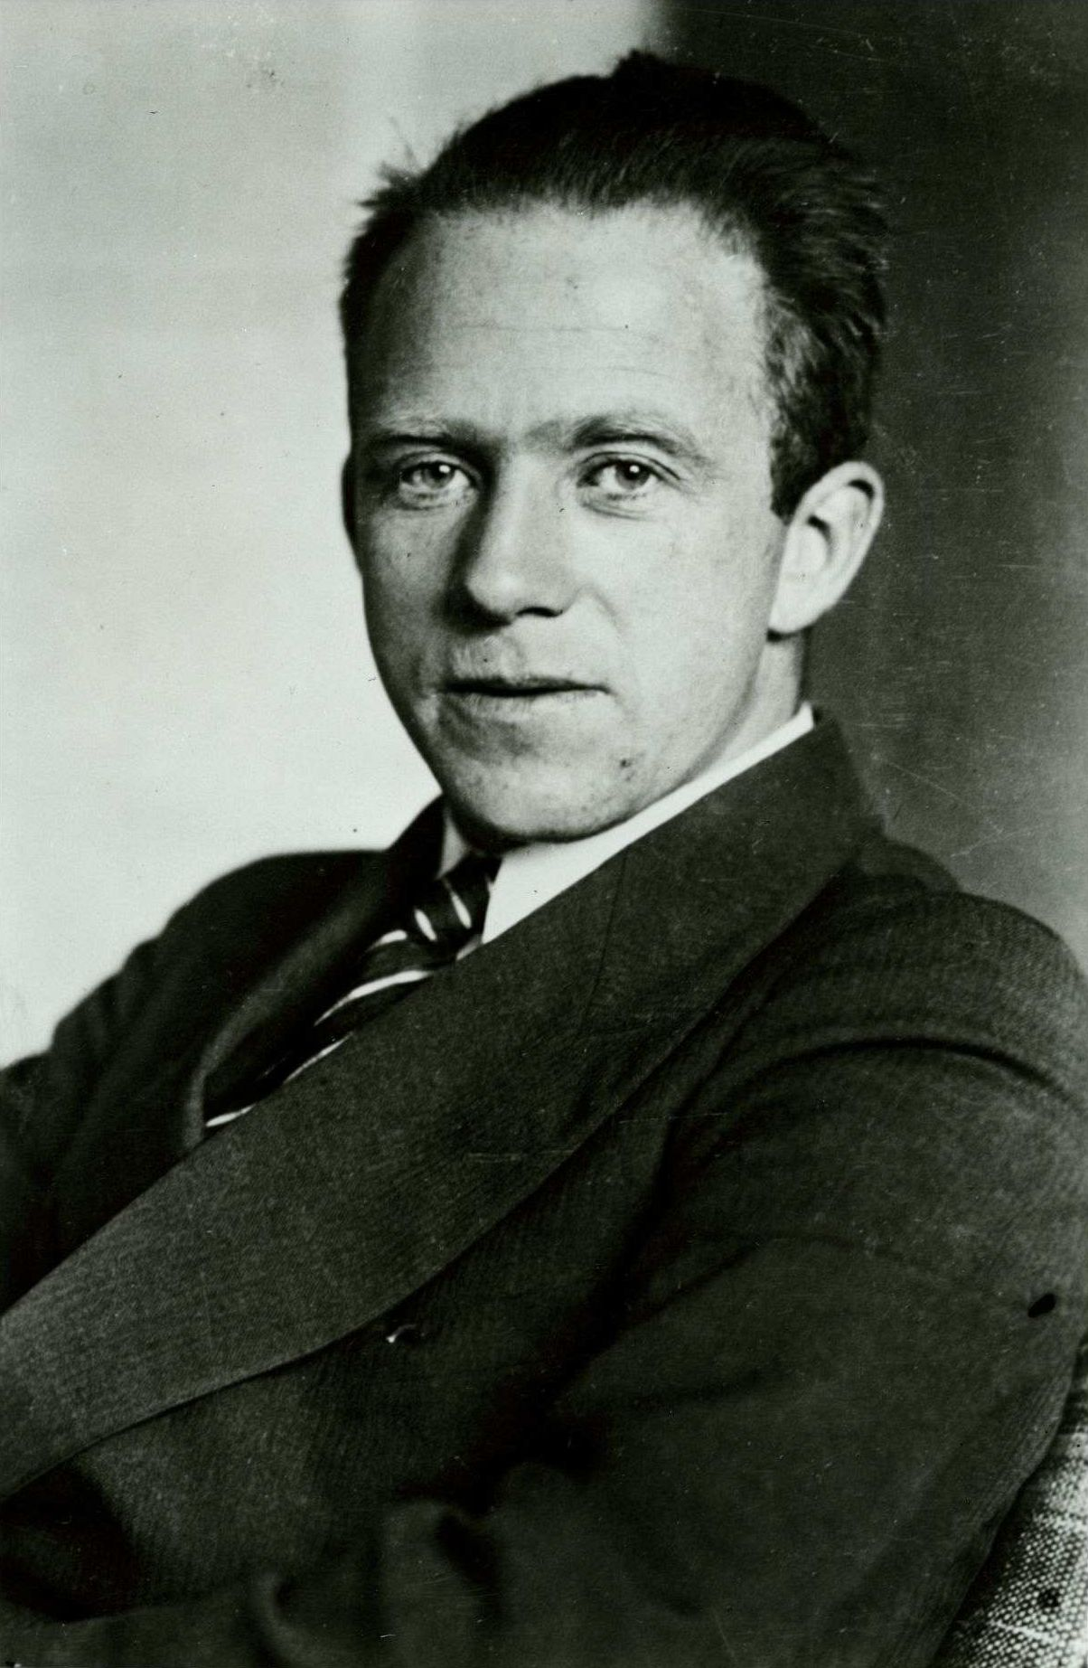
The Man Himself
Warner Heisenberg-1933
(Won the 1932 Nobel Prize in Physics for ‘the creation of quantum mechanics…’)

Slide 3
First, a question
Quantum mechanics means we can’t accurately depict how our particle will evolve because it has some particle properties and some wave properties which are difficult to understand
The particle has a position and momentum, but if you get quite detailed information about the position by doing some measurement, you can only get vague information about the momentum
We can’t create instruments accurate enough to find the particle’s exact position/momentum, because when you make a measurement of position and it creates a disturbance in the measurement of momentum. (For example, when hitting a particle with a photon/light to get its position, you need the light to have a very small wavelength, but it now has high energy/momentum which it gives to the particle, giving high uncertainty to momentum)
The particle is always in a bunch of different positions and momentums, like a fuzzy ball instead of a solid particle, and we can never tell that fuzzy ball’s position and momentum to a certain precision
The particle has a lot of different positions and momentums, but if we say the particle is “mostly” in a very small range of positions, then it is “mostly” in a large range of momenta.
Notes:
Looking glass inspo

Slide 4
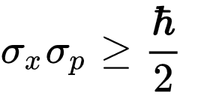
Notes:
Wikipedia commons

Slide 5
Again?
Quantum mechanics means we can’t accurately depict how our particle will evolve because it has some particle properties and some wave properties which are difficult to understand
The particle has a position and momentum, but if you get quite detailed information about the position by doing some measurement, you can only get vague information about the momentum
We can’t create instruments accurate enough to find the particle’s exact position/momentum, because when you make a measurement of position and it creates a disturbance in the measurement of momentum. (For example, when hitting a particle with a photon/light to get its position, you need the light to have a very small wavelength, but it now has high energy/momentum which it gives to the particle, giving high uncertainty to momentum)
The particle is always in a bunch of different positions and momentums, like a fuzzy ball instead of a solid particle, and we can never tell that fuzzy ball’s position and momentum to a certain precision
The particle has a lot of different positions and momentums, but if we say the particle is “mostly” in a very small range of positions, then it is “mostly” in a large range of momenta

Slide 6

Quantum mechanics means we can’t accurately depict how our particle will evolve because it has some particle properties and some wave properties which are difficult to understand
Quantum mechanics means we can’t accurately depict how our particle will evolve because it has some particle properties and some wave properties which are difficult to understand

Slide 7
The particle has a position and momentum, but if you get quite detailed information about the position by doing some measurement, you can only get vague information about the momentum
The particle has a position and momentum, but if you get quite detailed information about the position by doing some measurement, you can only get vague information about the momentum

Slide 8
We can’t create instruments accurate enough to find the particle’s exact position/momentum, because when you make a measurement of position and it creates a disturbance in the measurement of momentum. (For example, when hitting a particle with a photon/light to get its position, you need the light to have a very small wavelength, but it now has high energy/momentum which it gives to the particle, giving high uncertainty to momentum)
We can’t create instruments accurate enough to find the particle’s exact position/momentum, because when you make a measurement of position and it creates a disturbance in the measurement of momentum. (For example, when hitting a particle with a photon/light to get its position, you need the light to have a very small wavelength, but it now has high energy/momentum which it gives to the particle, giving high uncertainty to momentum)

Slide 9
The particle is always in a bunch of different positions and momentums, like a fuzzy ball instead of a solid particle, and we can never tell that fuzzy ball’s position and momentum to a certain precision
The particle is always in a bunch of different positions and momentums, like a fuzzy ball instead of a solid particle, and we can never tell that fuzzy ball’s position and momentum to a certain precision

Slide 10

Easy to Understand?
The particle has a lot of different positions and momentums, but if we say the particle is “mostly” in a very small range of positions, then it is “mostly” in a large range of momenta.

Slide 11
Back to the Beginning
One billion (10^9) = 11.5740741 days
One trillion (10^12) = 31.6887646 years
One billion (10^15) = 31 688.7646 years

Slide 12
Quantum

Slide 13
E=hf
Energy of a particle
=
Planck Constant
X
Frequency of light

Slide 14
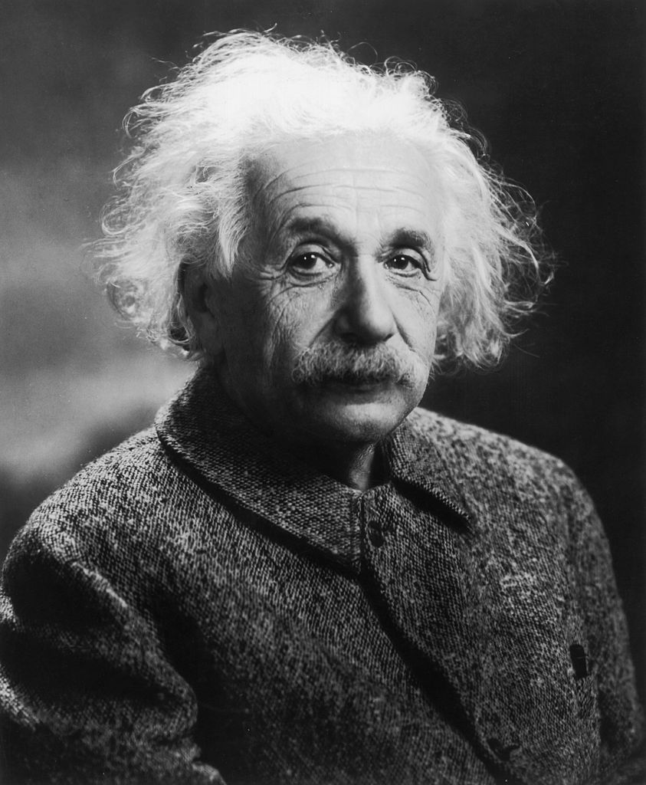
1921 Nobel Prize Winner
1921 Nobel Prize “…for his discovery of the law of the photoelectric effect.“”

Slide 15
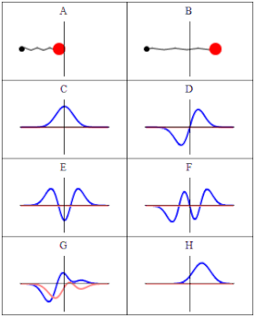
The Wavefunction
Notes:
Wikipedia commons source

Slide 16
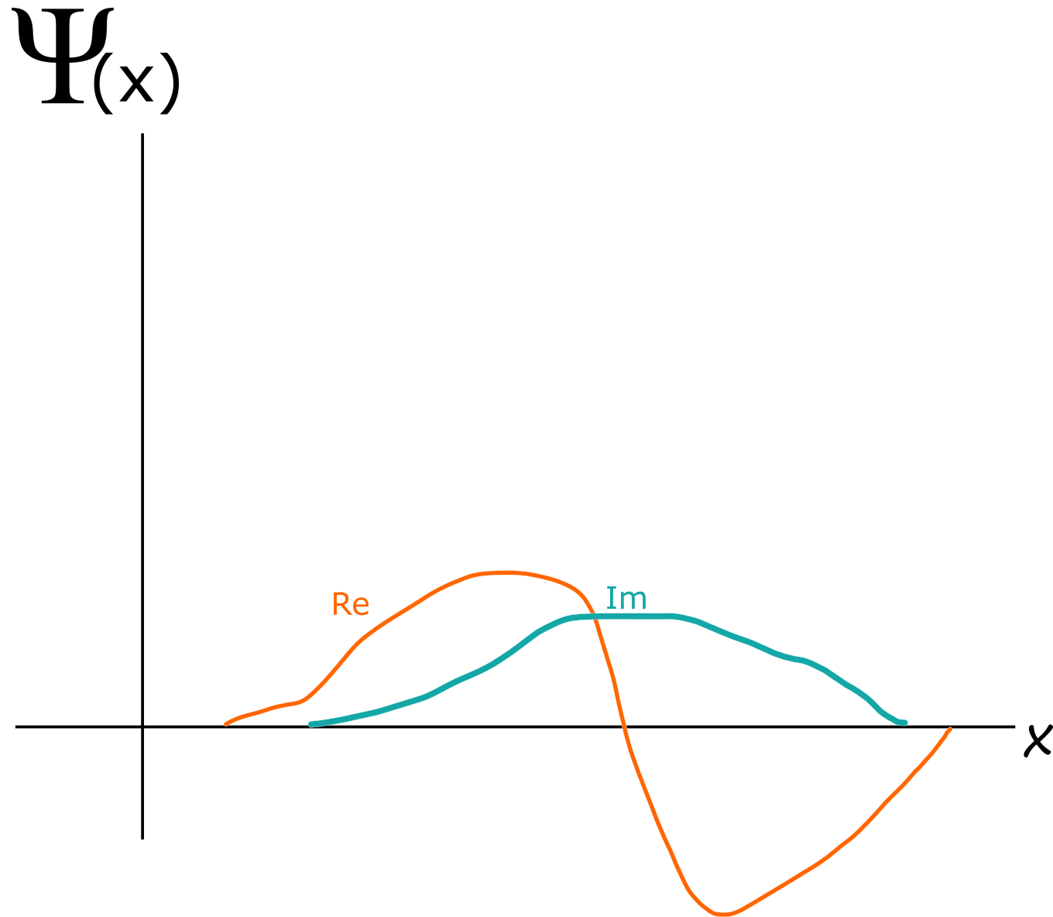
The Wavefunction

Slide 17
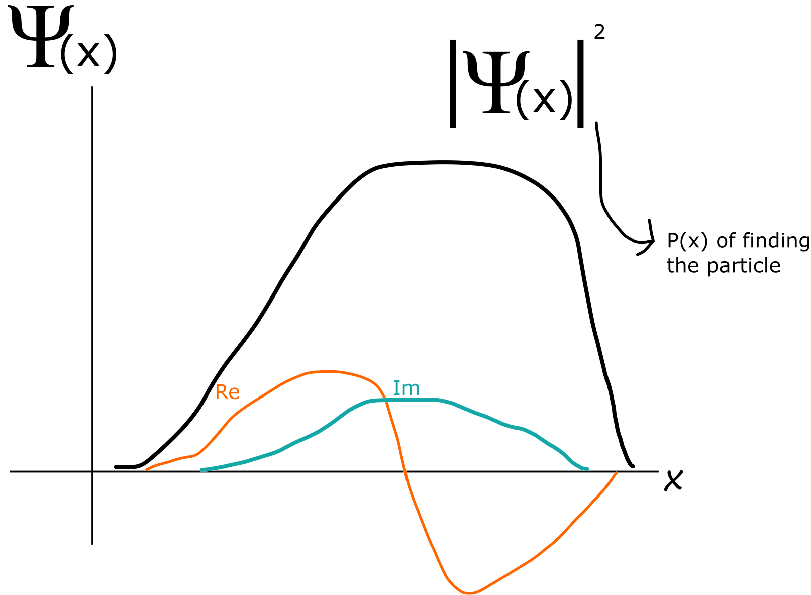
Born’s Rule

Slide 18
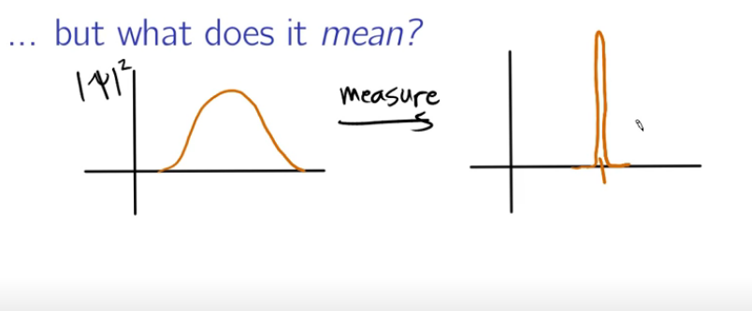
Wavefunction Collapse

Slide 19
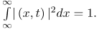
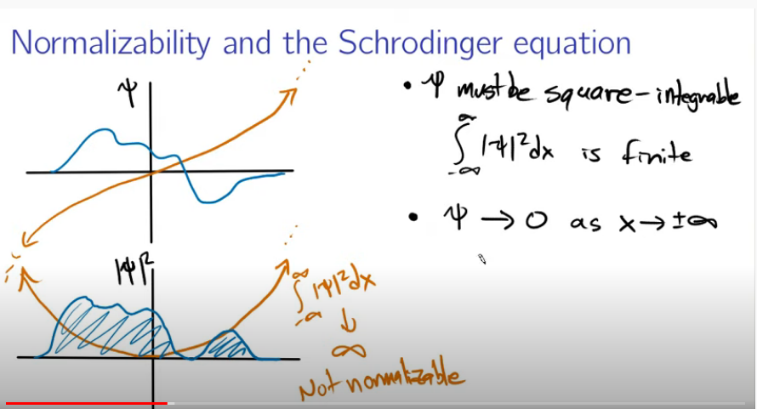
Normalisation

Slide 20
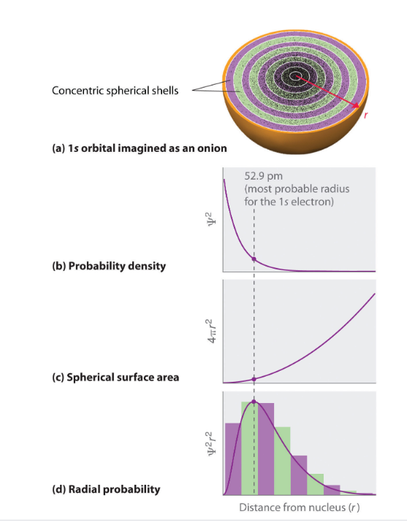
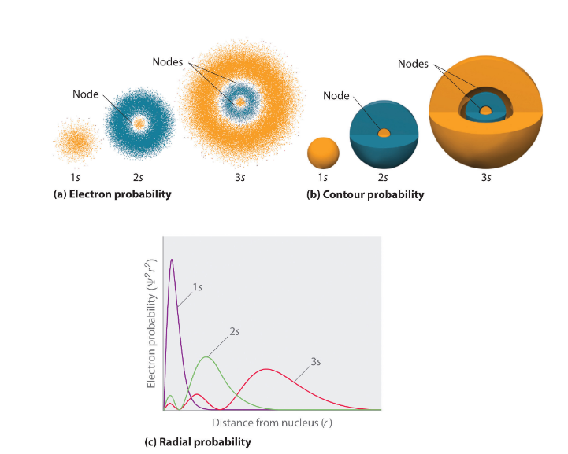
Why is this useful?

Slide 21

A 6s Electron Orbital Cross Section

Slide 22
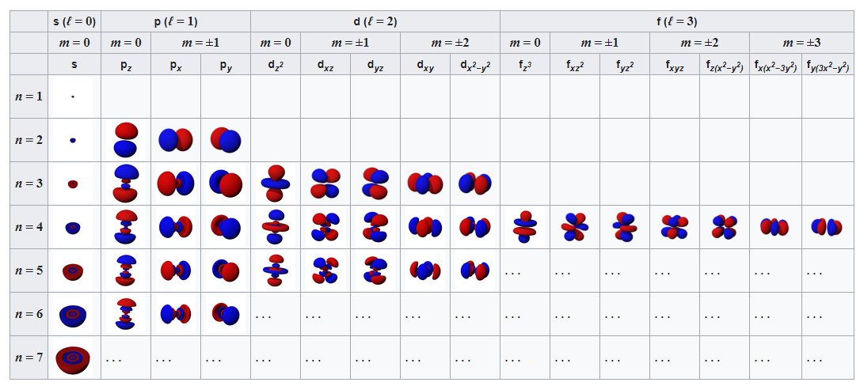

Slide 23
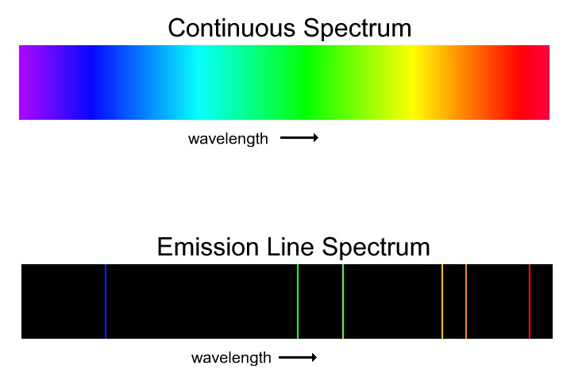
Emission Lines

Slide 24


Emission Lines
Hydrogen
Iron

Slide 25
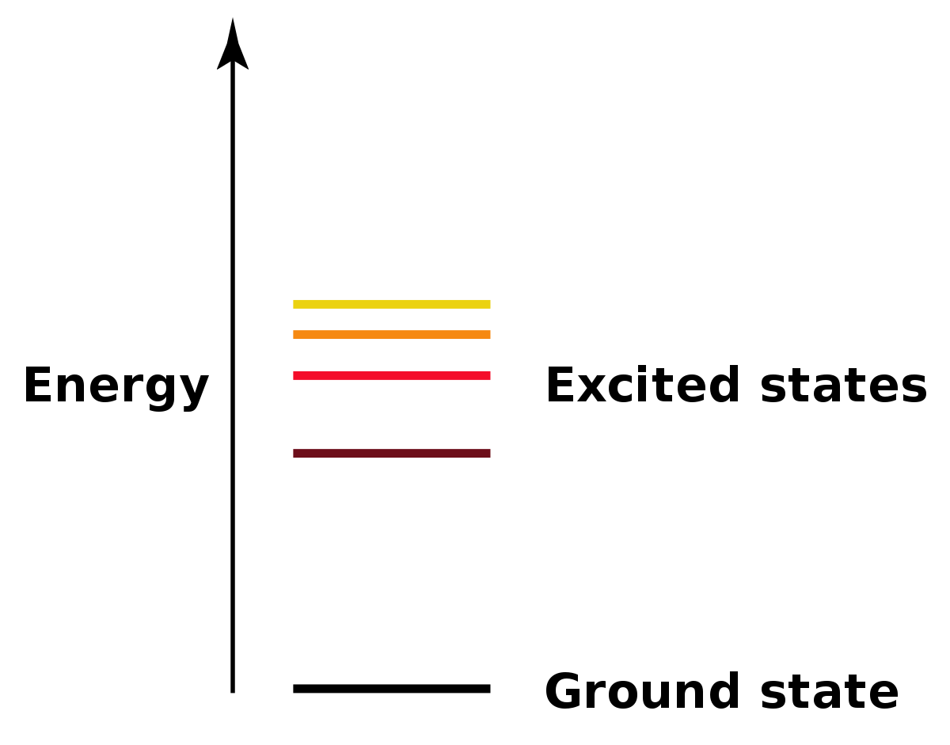
Energy levels
f=ΔE/h

Slide 26
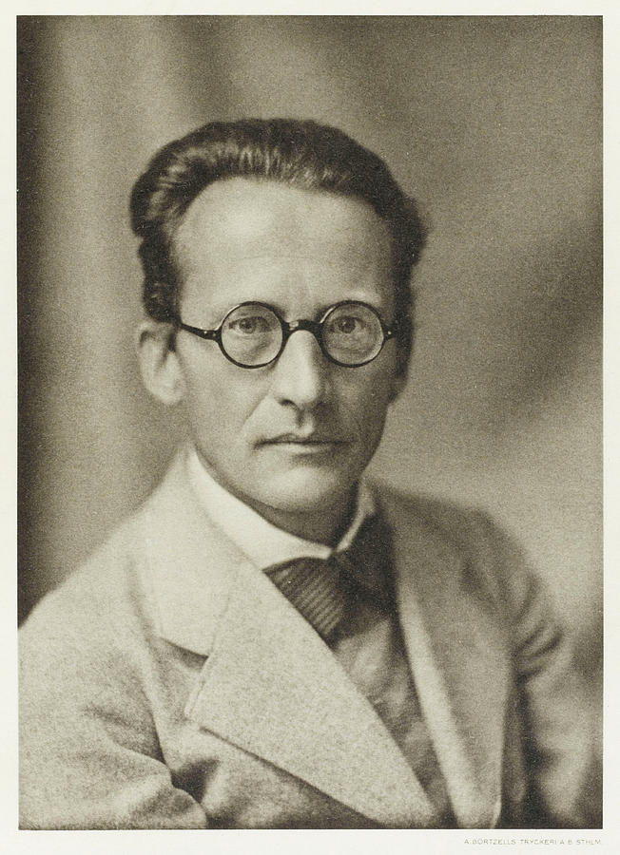
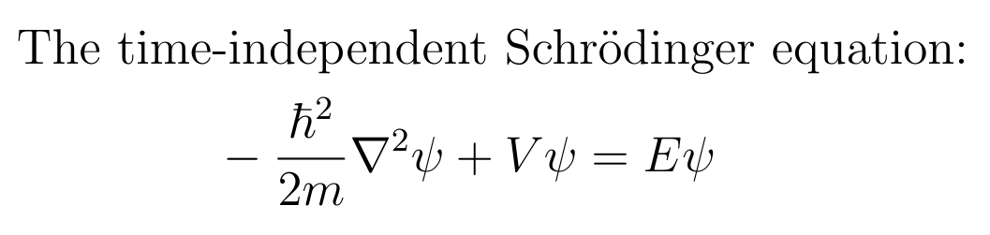
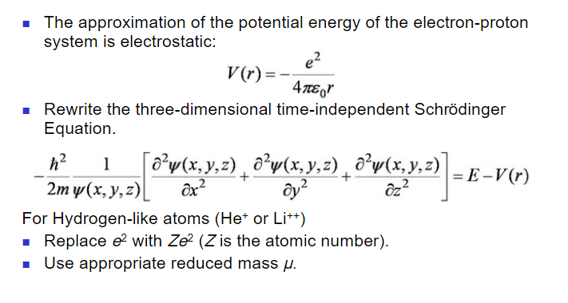
Calculating Electron Orbitals
Erwin Schrodinger-
1933 Nobel Prize Winner

Slide 27
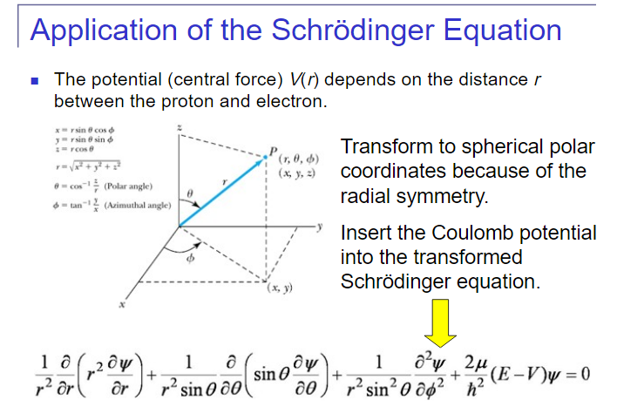
Calculating Electron Orbitals

Slide 28
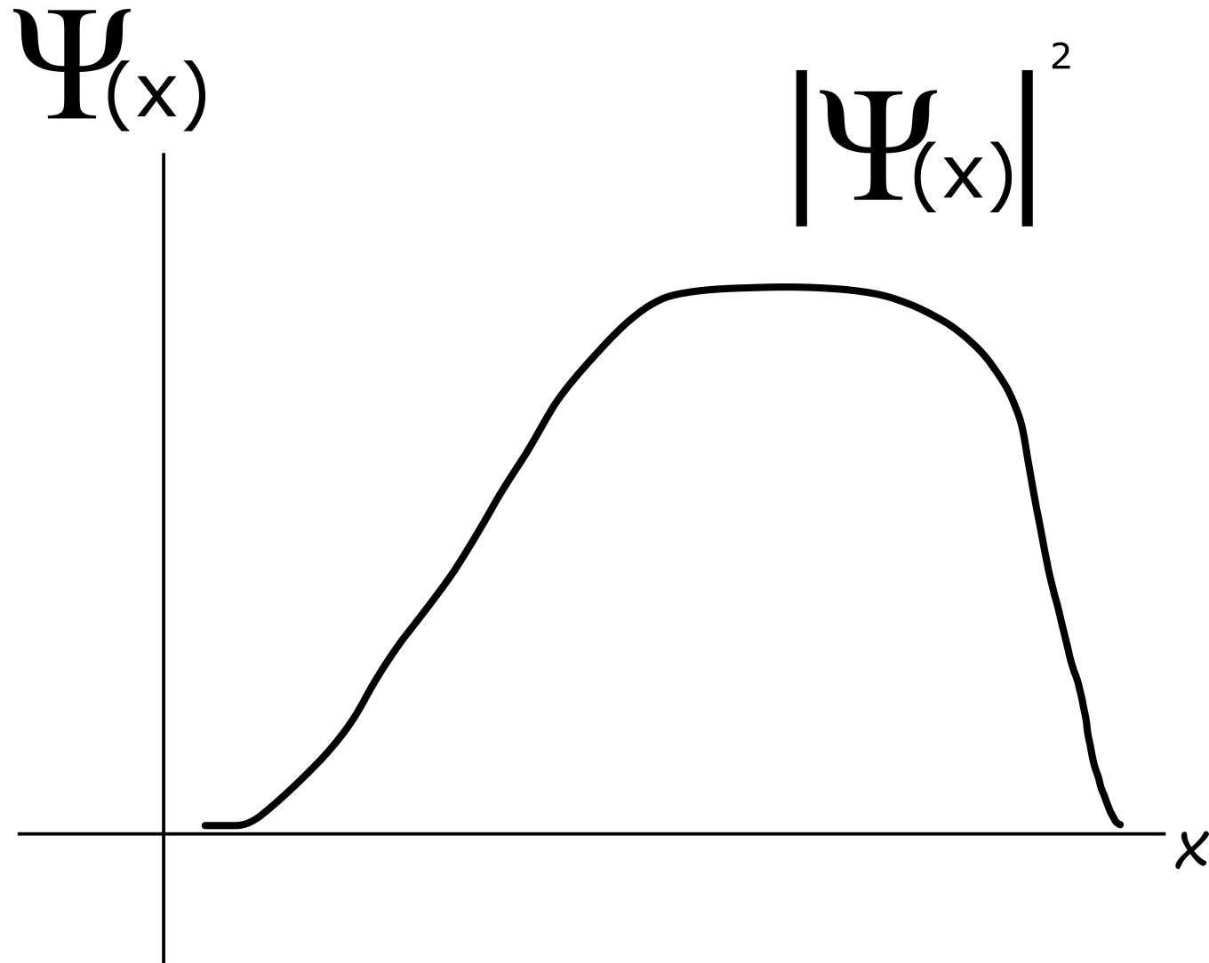
Wavefunction Properties
The wave function has an expectation value or “mean value”.
The wave function has a standard deviation and variance.

Slide 29
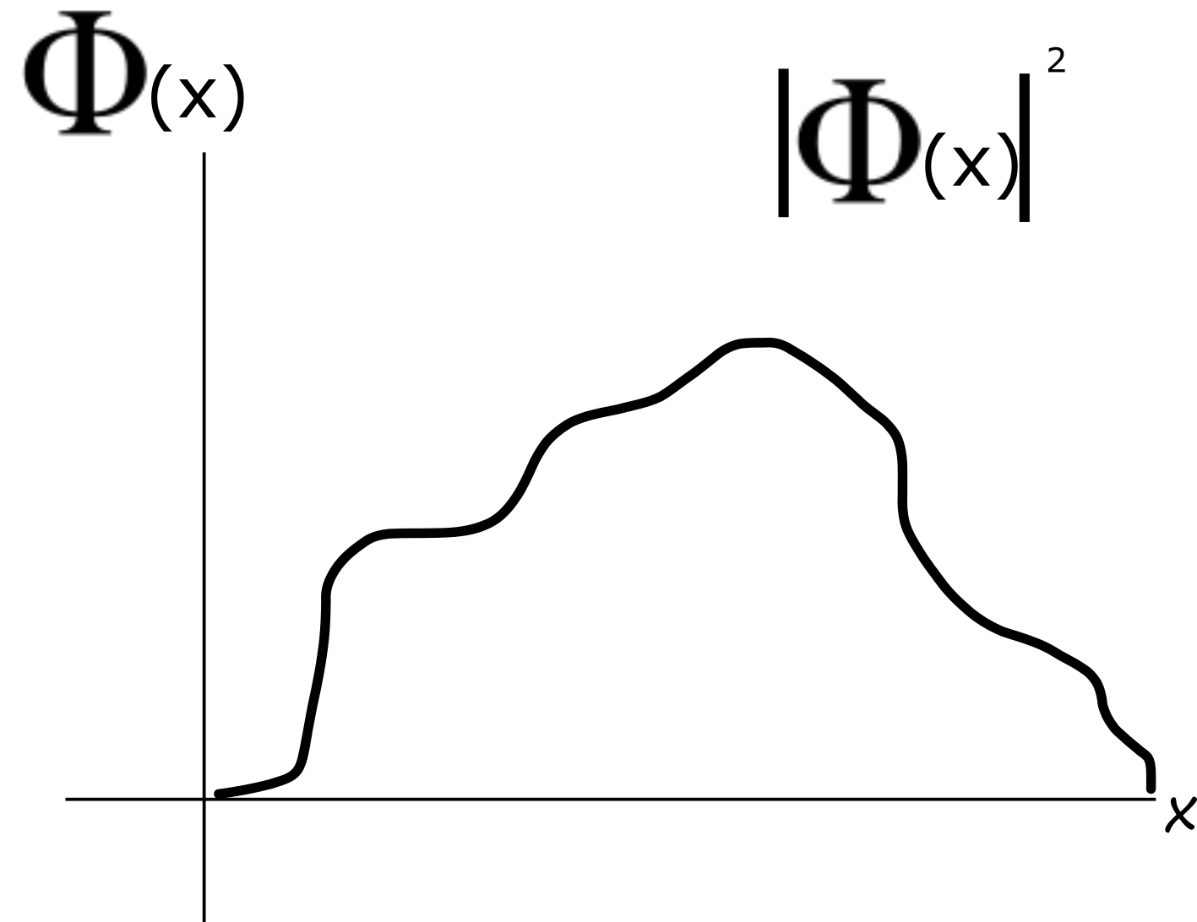
Wavefunction Properties
The wave function has an expectation value or “mean value”.
The wave function has a standard deviation and variance.

Slide 30
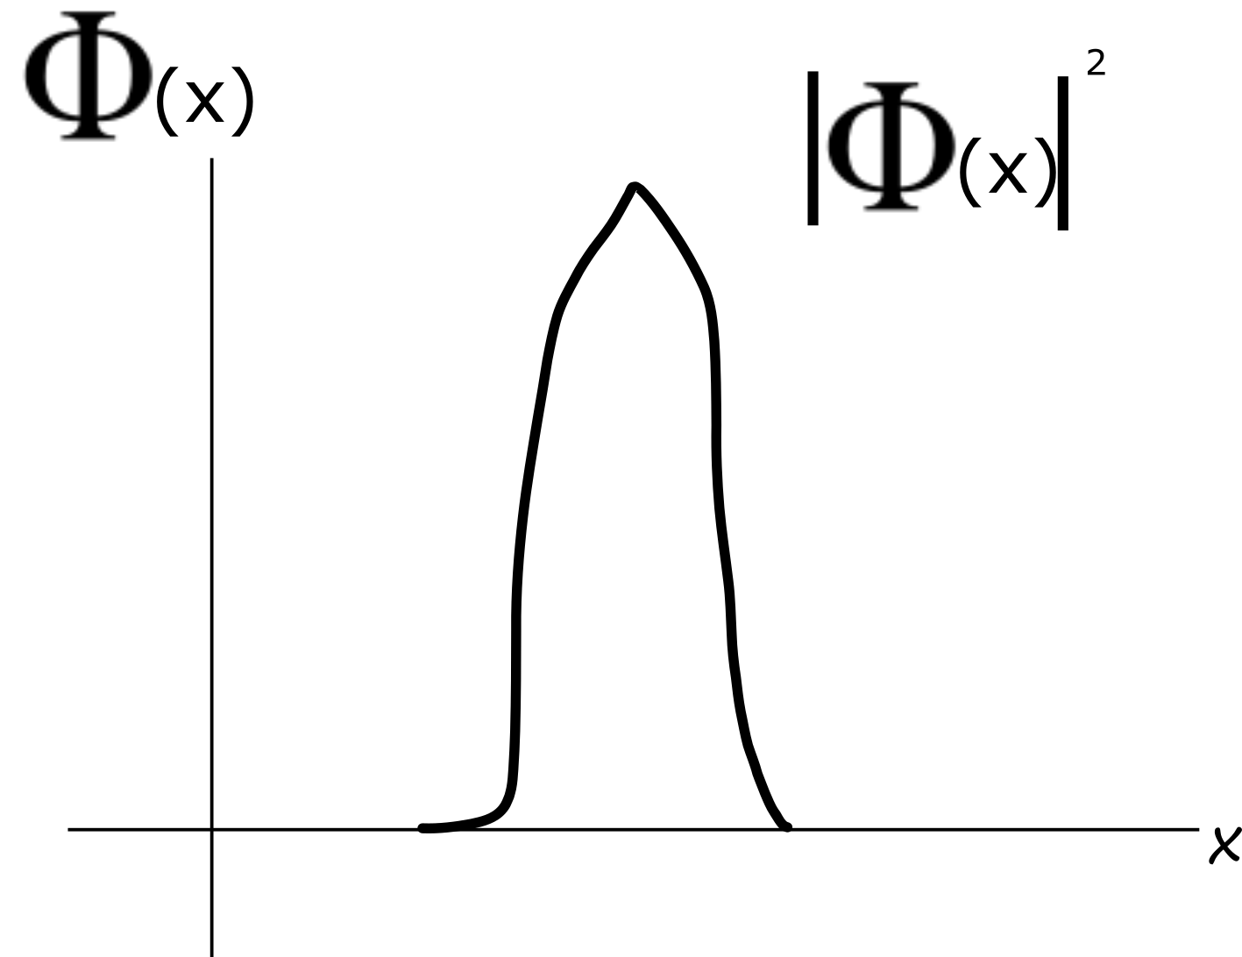
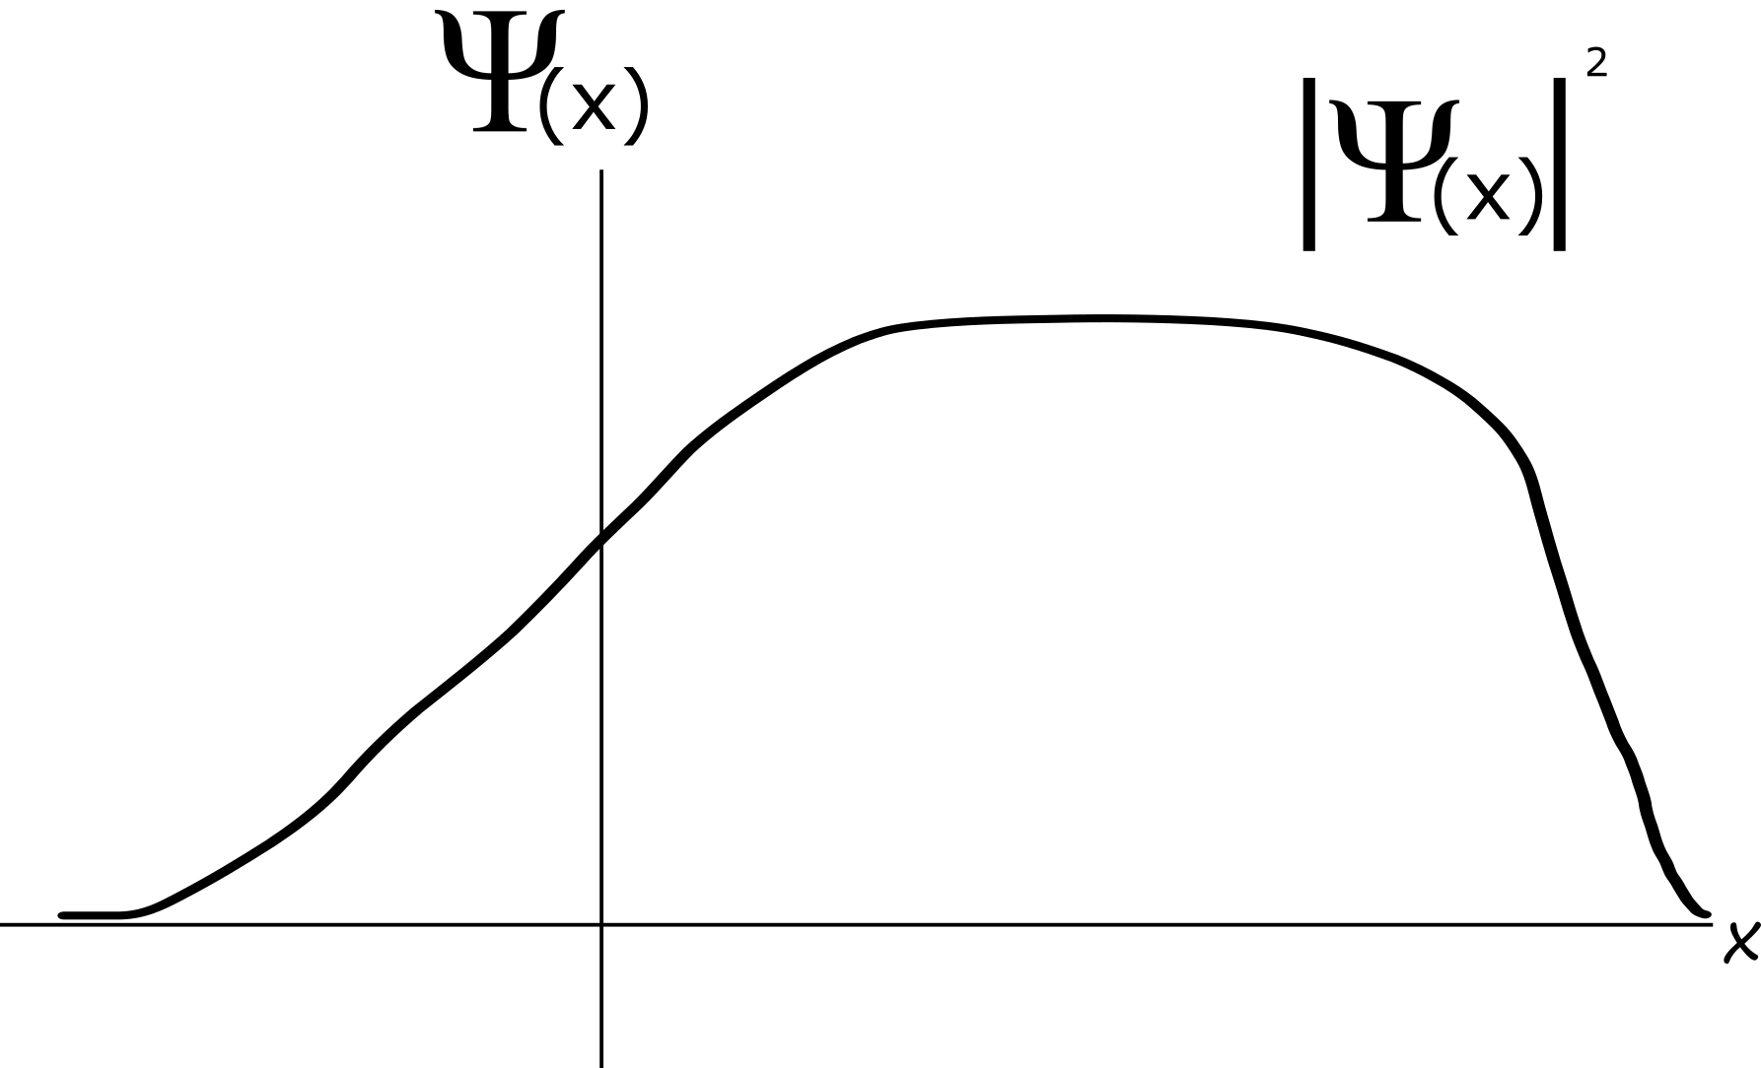
Wider
Narrower

Slide 31
Other Uncertainty Relations
Energy and Time
Angular Position and Momentum

Slide 32
WHY?
Non-zero commutation of operators (AB-BA)!= 0 or AB!=BA
Fourier transformation

Slide 33
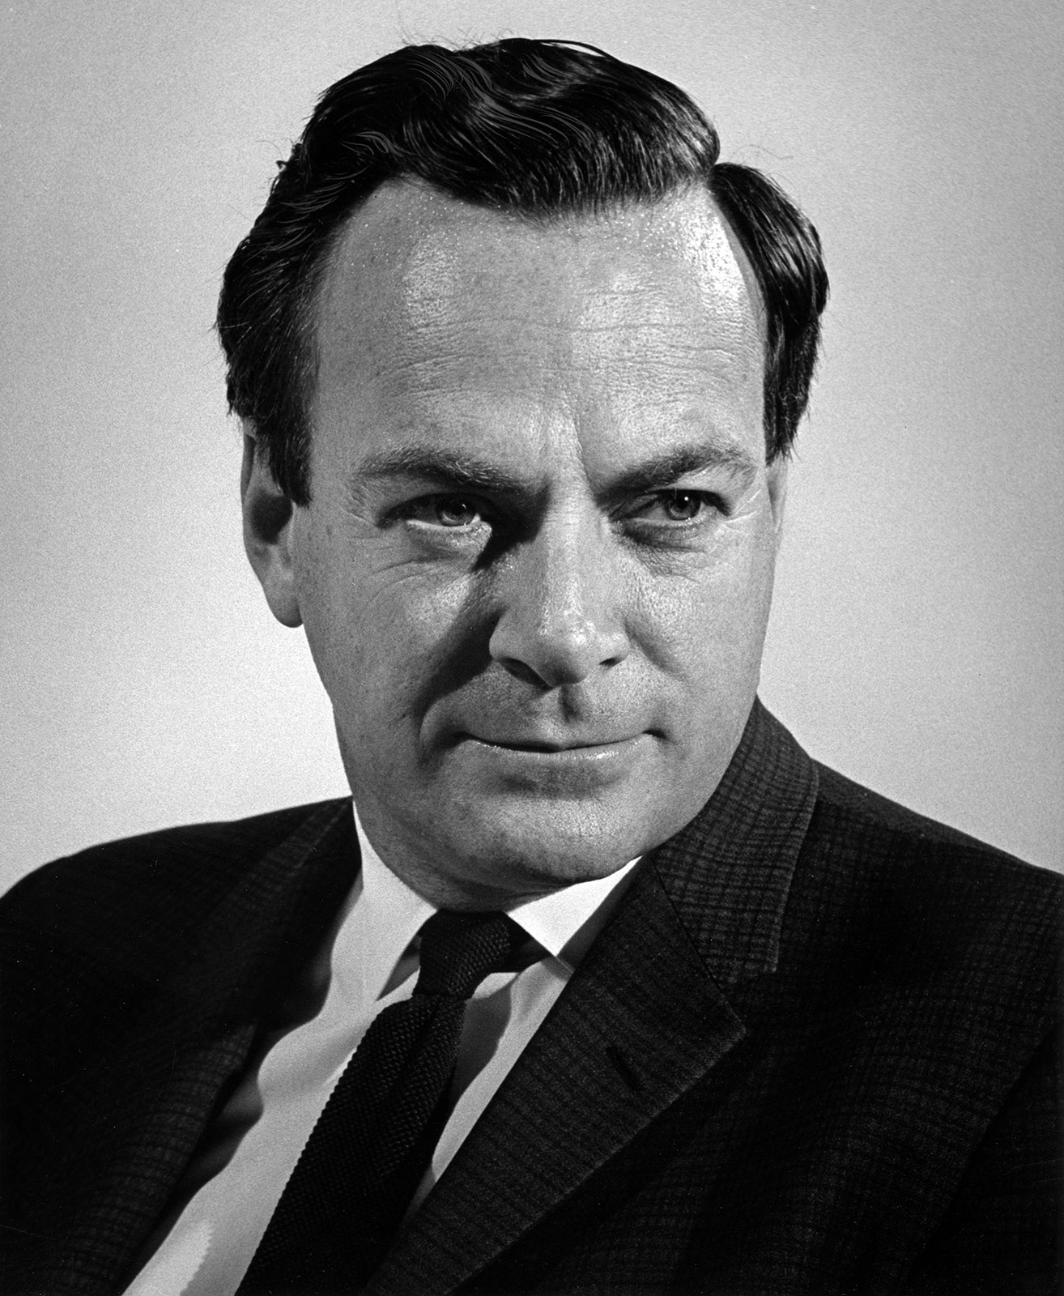
The Double Slit Experiment
Richard Feynman, a pretty good physicist
(Also 1965 Nobel Prize)

Slide 34
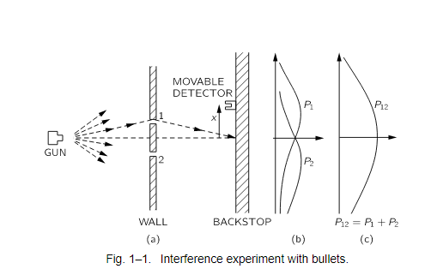
The Double Slit Experiment-With Bullets
(This thought experiment is taken from Feynman’s Lectures on physics)

Slide 35
The Double Slit Experiment-With Bullets
(This thought experiment is taken from Feynman’s Lectures on physics)

Slide 36
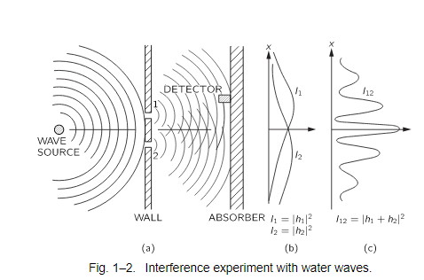
The Double Slit Experiment-With Waves

Slide 37
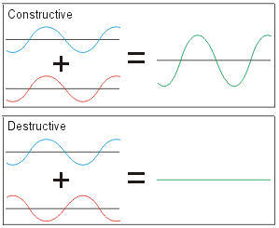
Interference

Slide 38
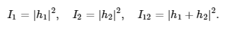
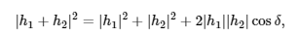
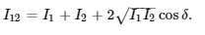
The Double Slit Experiment-With Waves

Slide 39
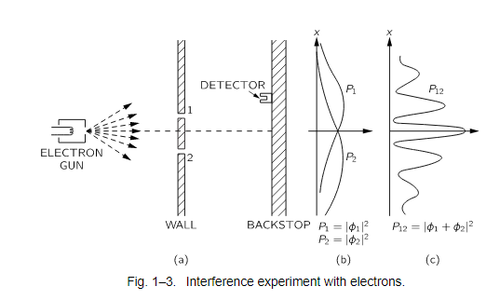
The Double Slit Experiment-With Electrons

Slide 40
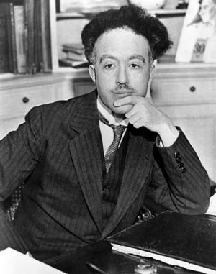
Waves and particles?
Louis de Broglie
(1929 Nobel Prize Winner)

Slide 41
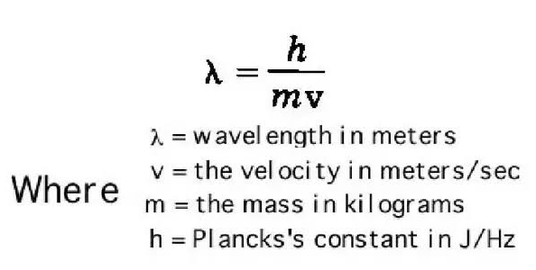
De Broglie Wavelength
f=E
F=Frequency
E=Energy of particle
h= Plancks’ Constant
h

Slide 42
The Reasoning?
E=mc^2
And E=hf
Mc^2=hf
Because real particles don’t travel at the speed of light, we say
Mv^2=hf
And then v=f *l
So mv^2= h * v /l
And then de Broglie wavelength l = h/mv
Where m*v is the momentum of a particle. So particles have a wavelength.

Slide 43
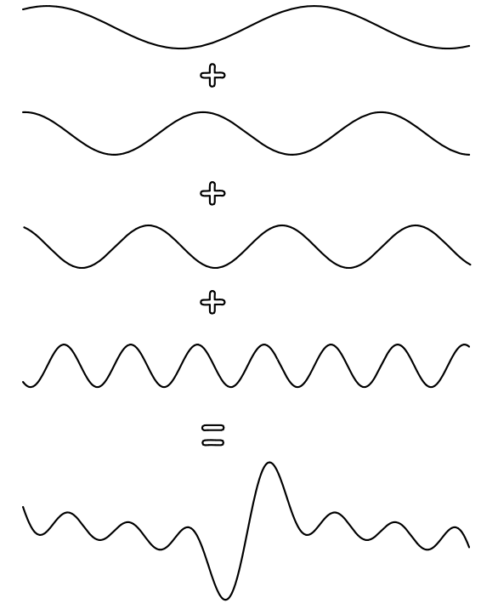
Superposing Waves
For individuals waves:
Certain Momentum
Completely Uncertain Position

Slide 44
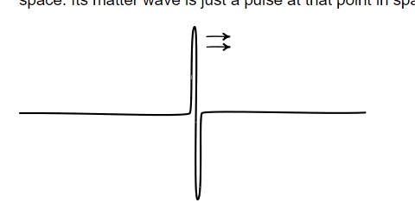
A Particle
For a localised particle:
Certain Position
Completely Uncertain Momentum (can’t evaluate wavelength)

Slide 45

Two Extremes

Slide 46
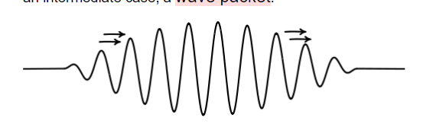
Particles-Wavepackets
Some uncertainty in position
Some uncertainty in momentum

Slide 47
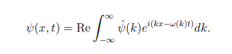
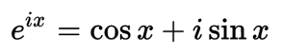
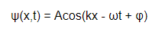
Mathematically Describing Wave Superposition
k = 2π/λ.
Where λ is DeBroglie Wavelength λ = h/p
k ∈ℝ
-Reminder
-Real part of Wavefunction
ω = 2πf.
Where λ is DeBroglie Frequency f = E/h
-PHI is just phase -insignificant

Slide 48
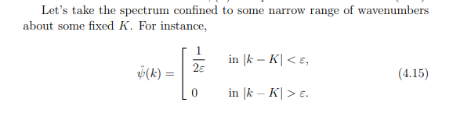
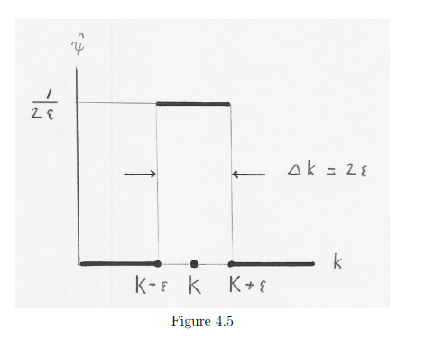
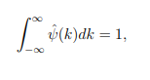
Wave Number Spectrum
Area=1

Slide 49
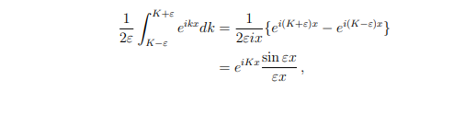
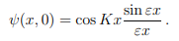
Evaluating the Superposition
Superposition at t=0
Taking the real part…

Slide 50
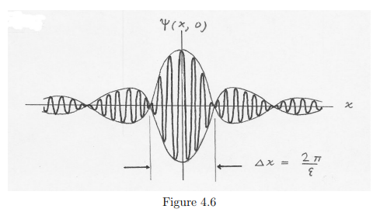
A wavepacket!

Slide 51
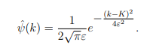
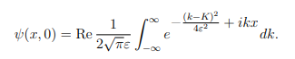
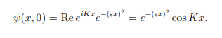
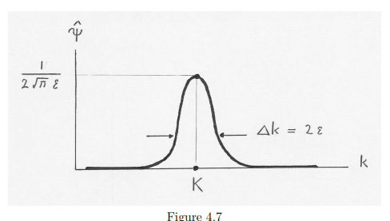
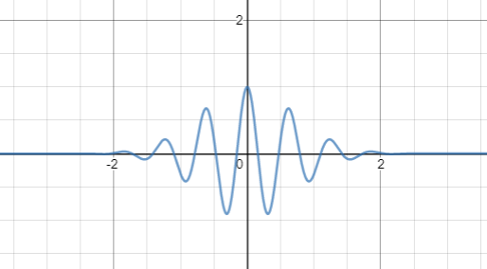
A Gaussian Spectrum
Which evaluates to:

Slide 52
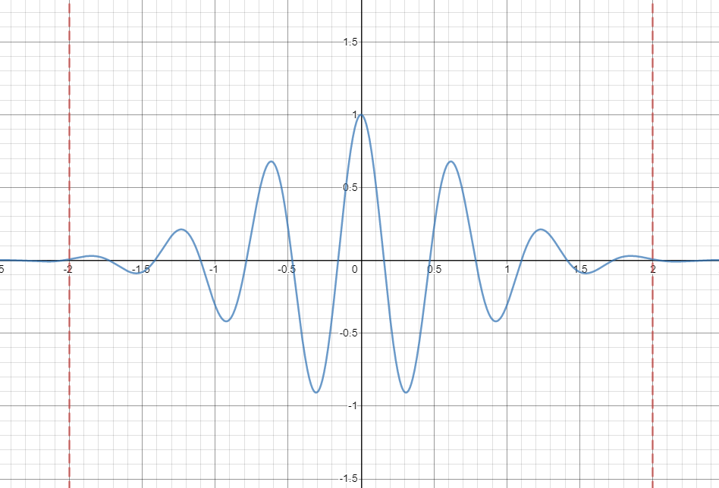
Uncertainty

Slide 53
Why Uncertainty?
Ungenauigkeitsrelationen
Unbestimmtheitsrelationen

Slide 54


Any Questions?

